Slide 1
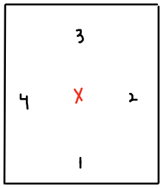
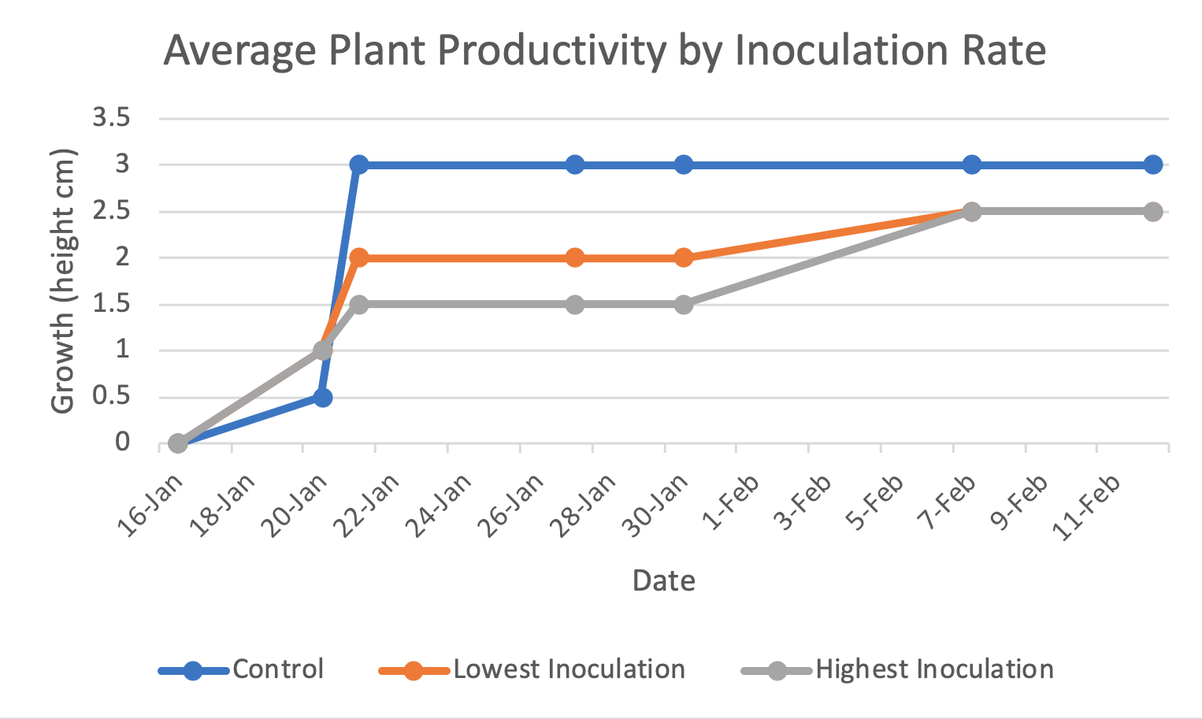
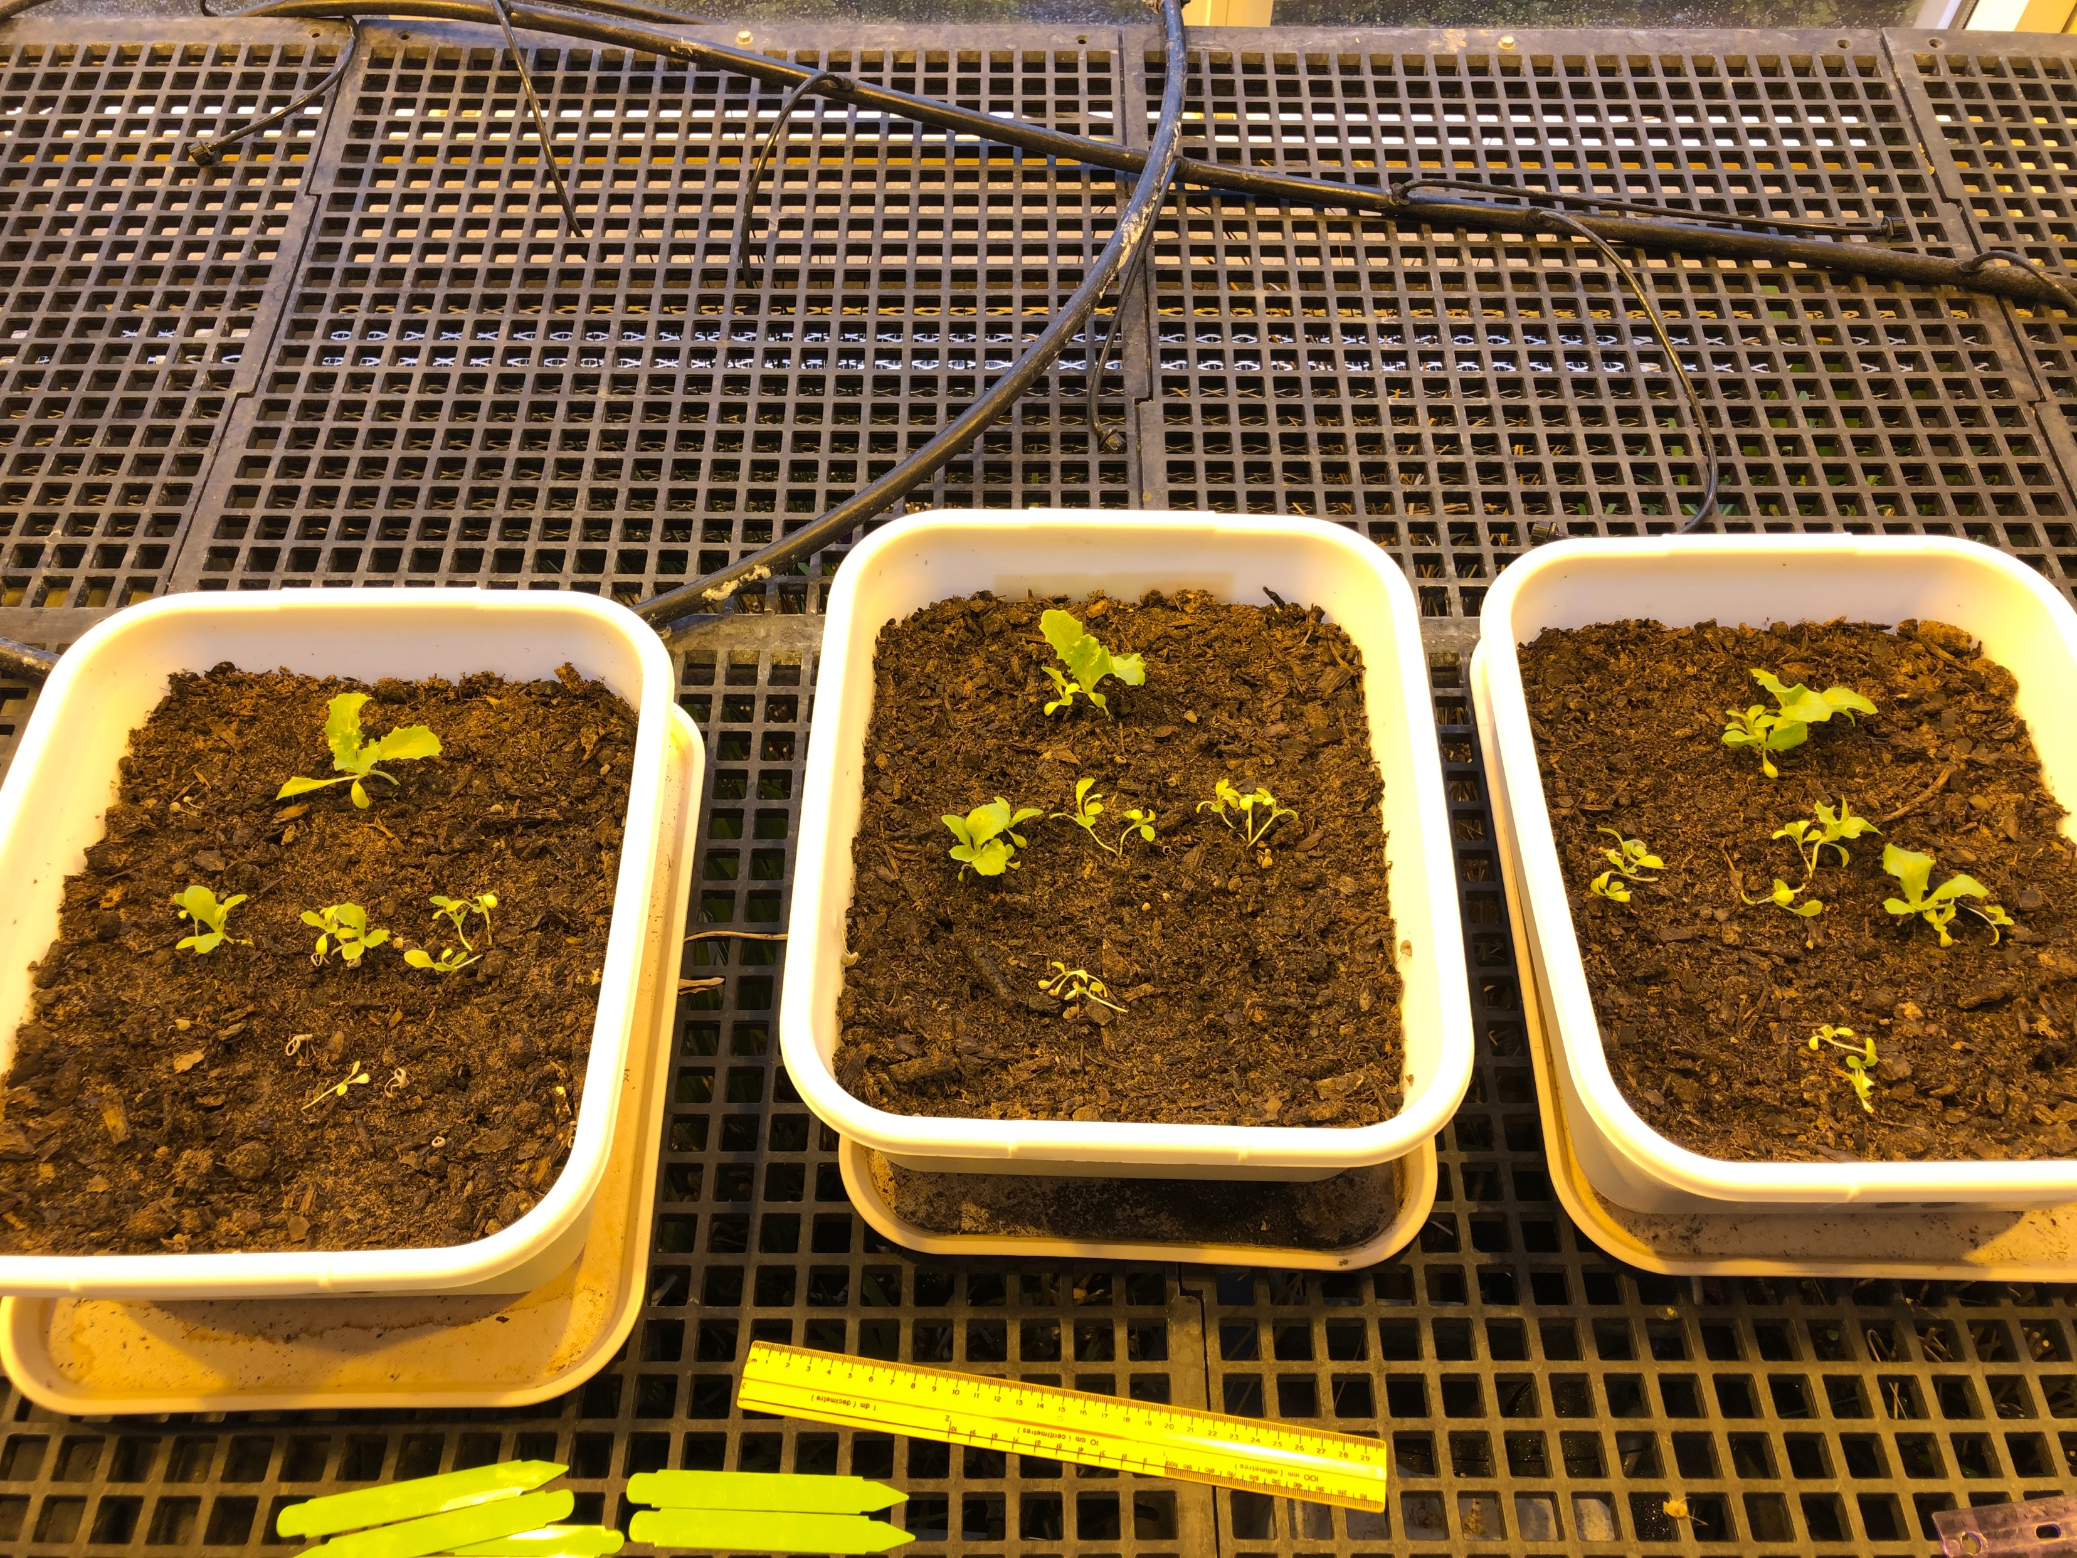
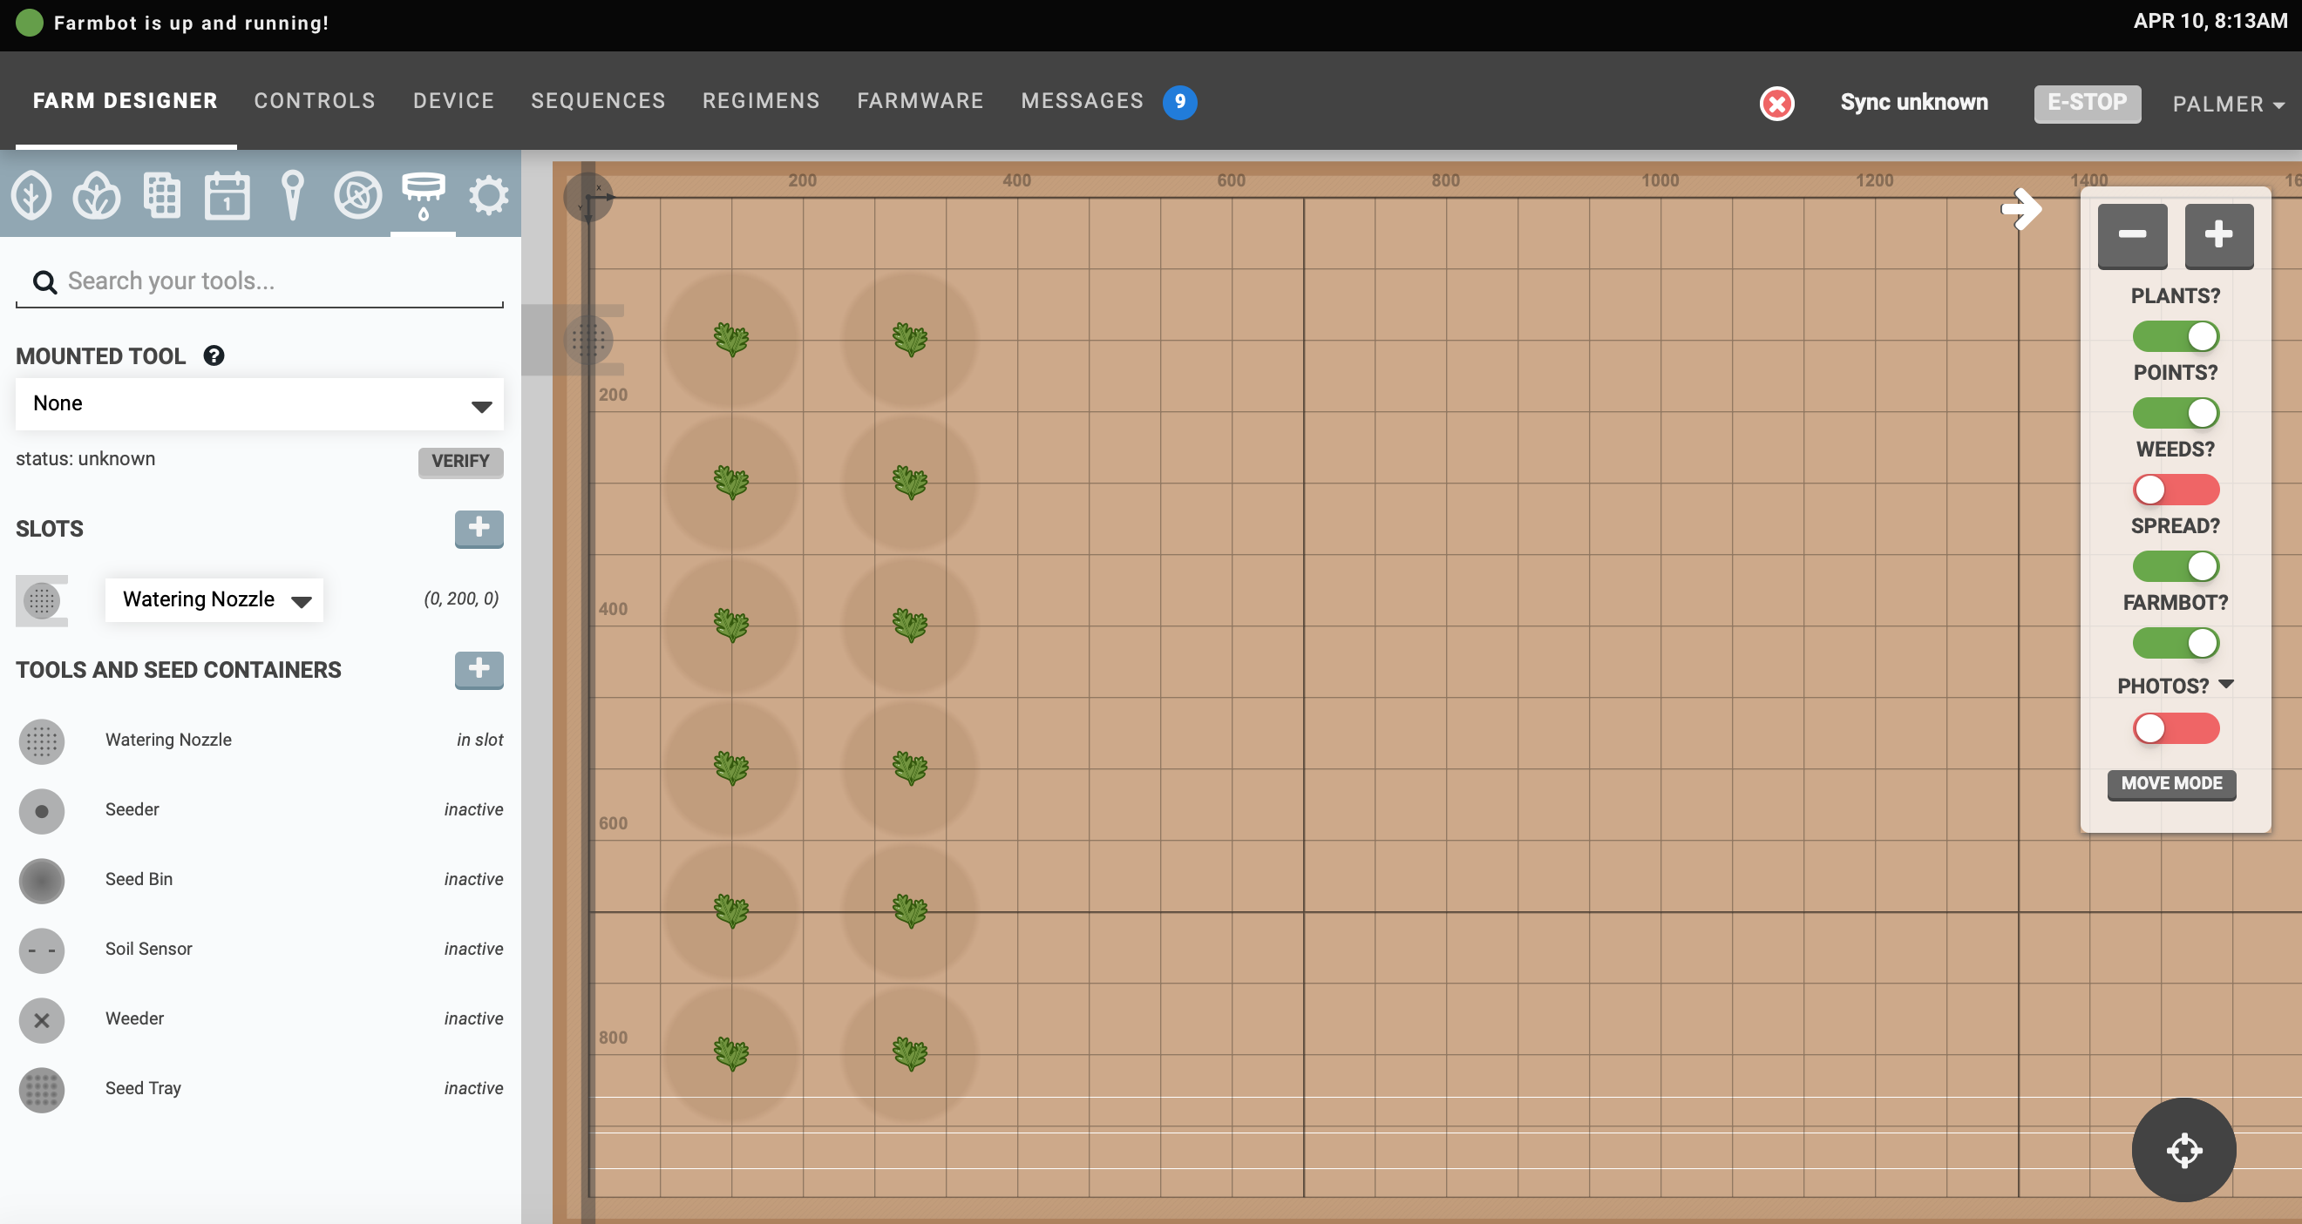
Soil microbes are important for plants to access limiting nutrients but do not outweigh the importance of necessary external factors.
Non-Cognitive Predictors of Student Success: A Predictive Validity Comparison Between Domestic and International Students
The Impact of Soil Microbes on Plant Productivity
Discussion and Automation
Discussion
We were unable to use the FarmBot to conduct the study due to lack of time to get it fully functional; in response to this an alternate study was conducted. Limitations of the alternate study mainly included space and the location in which it was conducted; the greenhouse may have had an uneven distribution of artificial vs. natural light based on the placement of the bins and plants.
While the results were overall inconclusive, they were not invaluable. The plants began to grow unhealthy and their health was not improved by the inoculation of Mammoth P microbes.
This is important to take note of for researchers and future applications because it creates new experimentation that looks at the importance of outside factors like sunlight and location over the importance of microbes, in order to focus not on the benefits of microbes, but their inabilities as well. This may show that there should not be as much of a reliance on microbes as previous studies may have implied.
Automation
To allow for precise control of both external factors and microbe concentration impacts, technology provides a perfect platform.
FarmBot
FarmBot is an automated CNC farming mechanism consisting of a gridded bed and robotic farming machine controlled by the user from any location and any device. While not fully set up for the study, its capabilities would have greatly improved the variables in which need to be controlled.
Some of FarmBot’s capabilities include:
Water
Plant
Weed
Photograph
With these abilities, precise work can be accomplished to isolate the impacts of just the soil microbes without external factors.
Palmer Mihalevich
BACKGROUND
Soil microbes are an important aspect of soil health that has the capability to improve plant productivity through the transformation of limiting nutrients into a usable form for plants. However, these capabilities of microbes may be overblown as only studies looking at their benefits have been designed. While the plant productivity should increase with the introduction of microbes into the soil, other outside factors have more impact on plant health and growth than microbes do.
Setup
The x represents the center
position.
The numbers represent each
relative position surrounding the center.
3 bins were used:
Control (0 microliters)
79 microliters
158 microliters
Dimensions of each bin:
28x34 cm
Positions 1-4 were planted in the middle between the center plant and the edge of the bin.
Bins were under artificial light but had natural sunlight (and supplemental light on a 12 hour photoperiod) shining from from the north side of each bin.
Procedure
Inoculation of microbes was applied to the center plant 1 cm down as close as possible to the base using micropipette
Treatment was applied every 8 days
Watered once every couple days roughly
Results
The results showed a lack in growth on average as time went on, with none of the plants ever growing more than 4 cm. Over time the plants grew unhealthy and pale as well, even with continued microbe inoculation. This implied that even with microbes present, they were unable to save some of the plants, which later died. As seen in the image, the plants in the 3rd position closest to the natural light grew the largest, while the plants in the 1st position farthest from the natural light grew the smallest, and in all bins ended up dying.
Figure 1: Plant growth by inoculation over 1 month. Productivity measured over plant height. Stagnant average growth after about a month of inoculation, despite varying inoculation concentrations. Concentrations were 0.0792 microliters/mL and 0.1585 microliters/mL.
Figure 2: An image of the FarmBot Farm Designer layout. Includes tabs with tools, a gridded system with plants that represents the real bed, and data surrounding each plant.
Take a picture to download the full paper

