Slide 1
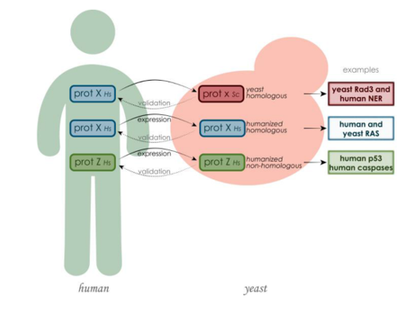
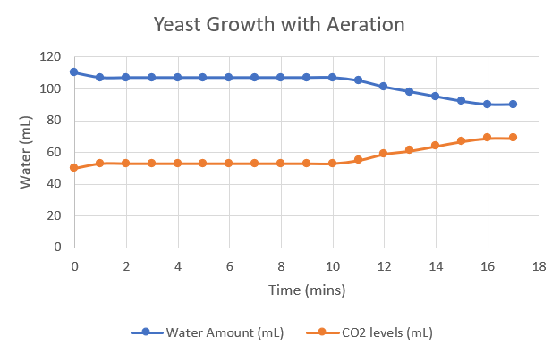
Yeast serves as a model organism for biological processes including cellular respiration
Yeast as a Model Organism Examining Biological Processes through S. Cerevisiae
Non-Cognitive Predictors of Student Success: A Predictive Validity Comparison Between Domestic and International Students
RAS pathways:
PRESENTER:
Divya Singh
BACKGROUND: What is the value of yeast as a model organism?
Saccharomyces cerevisiae (bakers' yeast) has been very important to biological studies due to its use as a 'model organism' to study biological processes
The term ‘model organism’ is widely used to describe yeast as it is easily obtained and heavily studied for experimental purposes. S. cerevisiae is the first eukaryote to have the entire genome sequenced and published, making it a model organism as certain pathways can be compared to human pathways, advancing studies in the medical field. The scientific community has adopted s. cerevisiae to study various biological processes including cellular respiration and protein synthesis.
METHODS
A scientific procedure published by “Science Buddies” was followed to measure cellular respiration with and without aeration. Revisions and improvements were made to this procure for a new protocol – linked on the manuscript
RESULTS
- Aeration in necessary for cellular respiration to occur
Normally, yeast goes through cellular respiration without oxygen. By aerating it, oxygen has been added and allows for the yeast to have suitable conditions for aerobic cellular respiration. This experiment evidently carried out respiration due to the CO2 being displaced into the chamber (the production of CO2 is a direct indication of cellular respiration)
The amino acid sequences and protein functions between yeast and human proteins are extremely similar, further allowing yeast to serve as a model organism.
This study examines the RAS pathway, and the role that this pathway places in autophagy (cleaning out damaged cells from the body). These studies have contributed to the advancements in cancer studies due to the interchangeability between proto-oncogenes and the RAS in yeast cells. Through this experiment, the usefulness of yeast as a model organism was brought to light, as it made way for cancer research to utilize yeast.
Discussion
Difficulties were faced due to the vague nature of the procedure. I adjusted the apparatus had in order for cellular respiration to occur; the amounts of yeast/glucose/etc. were adjusted accordingly.
Future studies:
I was not able to see that results that gene substitution could have on metabolism/cellular respiration. Following are potential ideas for future studies
gene manipulation, as it is a cheap way of studying the human body (rather than using live animals such as mice). Because yeast possesses so many similarities with the human genome, further studies can be carried out on s. cerevisiae to experiment many things in a cheap and effective manner.
the study of hereditary non-polyposis colorectal cancer using the genes MSH1 and MLH1. Another experiment to help cancer research could be examining mutated genes in yeast cell and how that affects cell division.
The effect of aeration on cellular respiration is examined using baker’s yeast. With aeration, conditions become more suitable for cellular respiration, as CO2 is observed to increase as the time progresses.
Take a picture to download the full procedure
Scan to watch Dr. Ben Blount explain the Synthetic Yeast Genome project
Scan for the full manuscript
Notes:
Notes:
In Powerpoint, click View > Guides
Keep text within gutter guides.
Author list: Don’t split names onto two lines (e.g., “Jimmy [break] Smith”). If that happens, use a new line, unless you need the space. Bold the first names of anybody who’s presenting in person.
Intro/methods/result: Do not drop below font size 28, but if you have extra space, jack up the font size until the space is full.
Do not use color in the sidebars except in graphs/figures. It’ll pull attention from the center and slow interpretation for passersby.

